Slide 1
JSP

Slide 2
1.OVERVIEW
JavaServer Pages (JSP) is a technology for developing Webpages that supports dynamic content.
This helps developers insert java code in HTML pages by making use of special JSP tags, most of which start with <% and end with %>.
A JavaServer Pages component is a type of Java servlet that is designed to fulfill the role of a user interface for a Java web application.
Web developers write JSPs as text files that combine HTML or XHTML code, XML elements, and embedded JSP actions and commands.
JSP tags can be used for a variety of purposes,such as
retrieving information from a database or registering user preferences.
Accessing JavaBeans components
Passing control between pages
Sharing information between requests, pages etc.

Slide 3
JSP is similar to CGI as program implementation.but JSP is better than CGI because:
Performance is significantly better because JSP allows embedding Dynamic Elements in HTML Pages itself instead of having separate CGI files.
JSP are always compiled before they are processed by the server unlike CGI/Perl which requires the server to load an interpreter and the target script each time the page is requested.
JavaServer Pages are built on top of the Java Servlets API, so like Servlets, JSP also has access to all the powerful Enterprise Java APIs, including JDBC, JNDI, EJB, JAXP, etc.
JSP pages can be used in combination with servlets that handle the business logic, the model supported by Java servlet template engines.

Slide 4
Following is the list of other advantages of using JSP over other technologies:
Vs. Active Server Pages (ASP) :
The advantages of JSP are twofold. First, the dynamic part is written in Java, not Visual Basic or other MS specific language, so it is more powerful and easier to use. Second, it is portable to other operating systems and non-Microsoft Web servers.
Vs. Pure Servlets :
It is more convenient to write (and to modify!) regular HTML than to have plenty of println statements that generate the HTML.
3. Vs. Server-Side Includes (SSI):
SSI is really only intended for simple inclusions, not for "real" programs that use form data, make database connections, and the like.
4. Vs. JavaScript :
JavaScript can generate HTML dynamically on the client but can hardly interact with the web server to perform complex tasks like database access and image processing etc.
5. Vs. Static HTML :
Regular HTML, of course, cannot contain dynamic information.

Slide 5
2.SET PATH
Install JDK and set path.
There are many servers to support for JSP,servlets etc., one of them is Apache tomcat.
Download Latest Apache tomcat version.
Once you downloaded the installation, unpack the binary distribution into a convenient location. For example, in C:\apache-tomcat-5.5.29 on windows.
Install any editor(ex.Eclipse).
Attach Tomcat files in eclipse in server options.

Slide 6
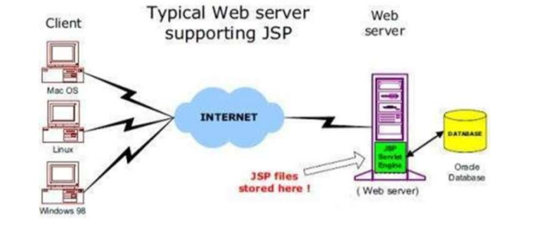
3.JSP ARCHITECTURE
The web server needs a JSP engine, i.e., a container to process JSP pages. The JSP container is responsible for intercepting requests for JSP pages.
Here we make use of Apache which has built-in JSP container to support JSP pages development.
A JSP container works with the Web server to provide the runtime environment and other services a JSP needs. It knows how to understand the special elements that are part of JSPs.

Slide 7
JSP Processing.
As with a normal page, your browser sends an HTTP request to the web server.
The web server recognizes that the HTTP request is for a JSP page and forwards it to a JSP engine. This is done by using the URL or JSP page which ends with .jsp instead of .html.
The JSP engine loads the JSP page from disk and converts it into a servlet content. This conversion is very simple in which all template text is converted to println( ) statements and all JSP elements are converted to Java code. This code implements the corresponding dynamic behavior of the page.
The JSP engine compiles the servlet into an executable class and forwards the original request to a servlet engine.

Slide 8
A part of the web server called the servlet engine loads the Servlet class and executes it. During execution, the servlet produces an output in HTML format. This output is further passed on to the web server by the servlet engine inside an HTTP response.
The web server forwards the HTTP response to your browser in terms of static HTML content.
Finally, the web browser handles the dynamically-generated HTML page inside the HTTP response exactly as if it were a static page.
Typically, the JSP engine checks to see whether a servlet for a JSP file already exists and whether the modification date on the JSP is older than the servlet.
If the JSP is older than its generated servlet, the JSP container assumes that the JSP hasn't changed and that the generated servlet still matches the JSP's contents. This makes the process more efficient than with the other scripting languages (such as PHP) and therefore faster.

Slide 9
4.JSP Life Cycle
Compilation
Parsing the JSP.
Turning the JSP into a servlet.
Compiling the servlet.
Initialization:
public void jspInit()
{
// Initialization code...
}
Execution :
void _jspService(HttpServletRequest request, HttpServletResponse response)
{
// Service handling code...
}
When a container loads a JSP it invokes the jspInit() method before servicing any requests. If you need to perform JSP-specific initialization, override the jspInit() method:

Slide 10
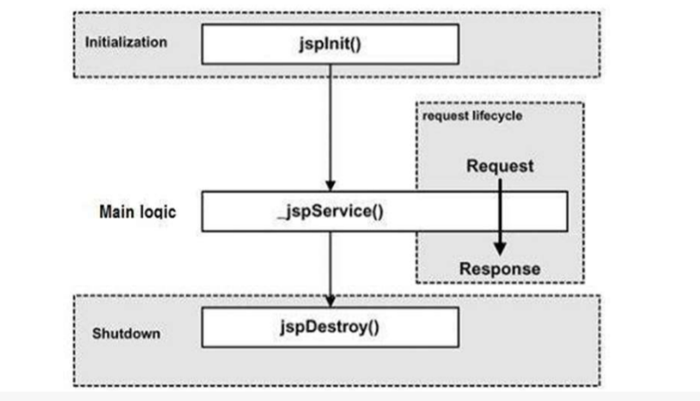
Whenever a browser requests a JSP and the page has been loaded and initialized, the JSP engine invokes the _jspService() method in the JSP.
The _jspService() method takes an HttpServletRequest and an HttpServletResponse.
Cleanup:
The jspDestroy() method is the JSP equivalent of the destroy method for servlets. Override jspDestroy when you need to perform any cleanup, such as releasing database connections or closing open files.
public void jspDestroy()
{
// Your cleanup code goes here.
}

Slide 11
JSP Directives
These directives provide directions and instructions to the container, telling it how to handle certain aspects of the JSP processing. A JSP directive affects the overall structure of the servlet class.
Directive | Description
<%@ page…%> | Defines page-dependent attributes, such as scripting language, error page, and buffering requirements.
<%@ include…%> | Includes a file during the translation phase.
<%@ taglib…..%> | Declares a tag library, containing custom actions, used in the page

Slide 12
<%@ page…..%>:
The page directive is used to provide instructions to the container. These instructions pertain to the current JSP page. You may code page directives anywhere in your JSP page. By convention, page directives are coded at the top of the JSP page. Syntax:
<%@ page attribute=“value” %>
You can write the XML equivalent of the above syntax as follows:
<jsp:directive.page attribute=“value”/>
Attributes:
1.buffer: Specifies a buffering model for output stream.(time re-directed to servlet response).
You may code a value of "none" to specify no buffering so that the servlet output is immediately directed to the response object or you may code a maximum (8 kb) buffer size in kilobytes, which directs the servlet to write to the buffer before writing to the response object.
<%@ page buffer=“none”%>

Slide 13
2.autoFlush:
The autoFlush attribute specifies whether buffered output should be flushed automatically when the buffer is filled, or whether an exception should be raised to indicate the buffer overflow. A value of true (default) indicates automatic buffer flushing and a value of false throws an exception.
A value of true (default) indicates automatic buffer flushing and a value of false throws an exception.
3.contentType:
Sets the character encoding for the JSP page and for the generated response page. The default content type is text/html, which is the standard content type for HTML pages.
<%@ page autoFlush="false“ %>
<%@ page contentType="text/xml” %>

Slide 14
In the same we can write <%@ page contentType=“text/html”%> <%@ page contentType=“application/msword”%> <%@ page contentType=“text/html:charset=ISO-8859-1”%>
4.errorPage:
It tells the JSP engine which page to display if there is an error while the current page runs. The value of the errorPage attribute is a relative URL.
5.isErrorPage:
It indicates that the current JSP can be used as the error page for another JSP. The value of isErrorPage is either true or false. The default value of the isErrorPage attribute is false. For example, the handleError.jsp sets the isErrorPage option to true because it is supposed to handle errors:
<%@ page errorPage=“Myerrorpage.jsp”%>
<%@ page isErrorPage=“true”%>

Slide 15
6.extends:
It specifies a superclass that the generated servlet must extend. For example, the following directive directs the JSP translator to generate the servlet such that the servlet extends somePackage.SomeClass:
7.import:
To import packages.
8.Info:
It lets you provide a description of the JSP.
<%@ page extends=“somePackage.SomeClass” %>
<%@ page import=“java.sql.*” %>
<%@ page inf0=“This JSP page written by Ramya” %>

Slide 16
9.isThreadSafe:
It marks a page as being thread-safe. By default, all JSPs are considered thread-safe. If you set the isThreadSafe option to false, the JSP engine makes sure that only one thread at a time is executing your JSP.
10.language:
Indicates the programming language used in scripting the JSP page.
11.session:
Indicates whether or not the JSP page uses HTTP sessions. A value of true means that the JSP page has access to a builtin session object and a value of false means that the JSP page cannot access the builtin session object. such as session.getCreationTime() or session.getLastAccessTime().
<%@ page isThreadSafe=“false”%>
<%@ page language=“java”%>
<%@ page session=“true”

Slide 17
12.isELIgnored:
It gives you the ability to disable the evaluation of Expression Language (EL) expressions which has been introduced in JSP 2.0.
13.isScriptingEnabled:
It determines if the scripting elements are allowed for use.
<%@ page isELIgnored=“false”%>
<%@ page isScriptingEnabled=“false”%>

Slide 18
<%@ include …… %>:
1.file:To include files in same page or direct to multiple pages.
<%@ taglib…..%>:
It declares that your JSP page uses a set of custom tags, identifies the location of the library, and provides means for identifying the custom tags in your JSP page.
<%@ include file=“filename.jsp”%>
<%@ taglib uri="uri" prefix="prefixOfTag“ >

Slide 19
JSP ACTIONS
Actions use constructs in XML syntax to control the behavior of the servlet engine. You can dynamically insert a file, reuse JavaBeans components, forward the user to another page, or generate HTML for the Java plugin.
Syntax:
There are two attributes that are common to all Action elements:
The id attribute :
The id attribute uniquely identifies the Action element, and allows the action to be referenced inside the JSP page.
The scope attribute:
determines the lifespan of the object associated with the id. The scope attribute has four possible values: (a) page, (b)request, (c)session, and (d) application.
<jsp:action_name attribute="value“/>

Slide 20
jsp:include:
Includes a file at the time the page is requested.
NOTE: Unlike the include directive, which inserts the file at the time the JSP page is translated into a servlet, this action inserts the file at the time the page is requested.
Following is the list of attributes associated with the include action:
Page : The relative URL of the page to be included.
Flush : The boolean attribute determines whether the included resource has its buffer flushed before it is included.
<jsp:usebean>:
The useBean action is quite versatile. It first searches for an existing object utilizing the id and scope variables. If an object is not found, it then tries to create the specified object.
<jsp:include page=“relative URL” flush=“true”/>
<jsp:useBean id=“name” class “Package.class”/>

Slide 21
Once a bean class is loaded, you can use jsp:setProperty and jsp:getProperty actions to modify and retrieve the bean properties.
Following are lists of the attributes associated with useBean action:
class :Designates the full package name of the bean.
type: Specifies the type of the variable that will refer to the object.
beanName: Gives the name of the bean as specified by the instantiate () method of the java.beans.Beans class.

